Slide 1
Talk2Metro

Slide 2
Description
Talk2Metro is mobile application designed to simplify the metro travel
experience for Commuters. It integraters various features such as such as
real-time metro maps, ticket booking, payment processing, and travel logs to
enhance the user journey. The app aims to provide a seamless, efficient, and
user-friendly experience, making metro travel easier and more accessible.

Slide 3
Problem Statement
The Bangladesh metro rail system plays a crucial role in facilitating urban
transportation and easing congestion in Dhaka city. However, the current
ticket booking process faces several challenges, including limited
accessibility for illiterate and visually impaired passengers, long queues at
ticket counters, and reliance on cash transactions.

Slide 4
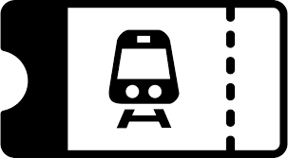
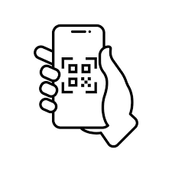
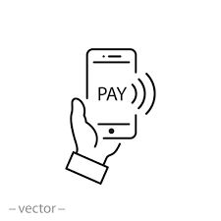
Features
Online Booking Portal
Bar Code Tracker
Cashless Transactions

Slide 5
Stakeholders
Primary Stakeholders
Secondary Stakeholders
Daily Passengers
Tourists
Metro Rail Station Staff
Metro Rail Authorities

Slide 6
Functional Requirements
User Authentication
Route Mapping
Ticket Booking
Ticket Generation and Bar code
User Interface

Slide 7
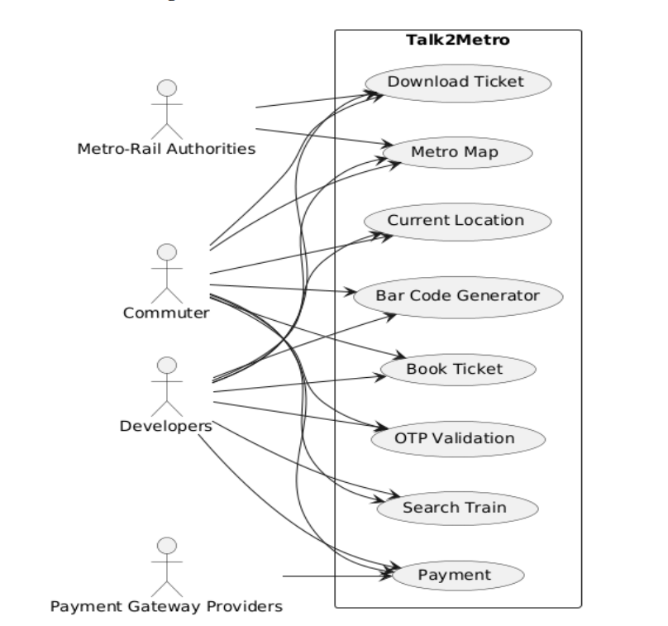
Use Case Diagram

Slide 8
Tools & Technology
API:
SSLCOMMERZ
Geolocation
Direction API
Places API
Tools:
Flutter
Firebase
IDE:
Android Studio
Language:
Dart

Slide 9
Software Demo

Slide 10
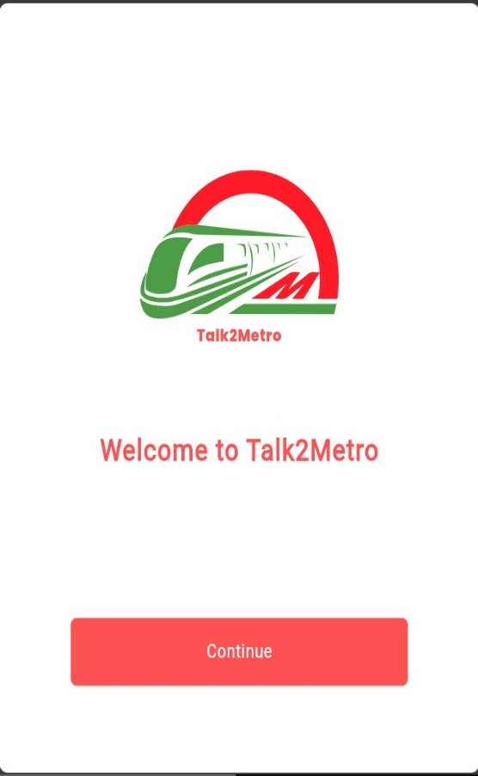
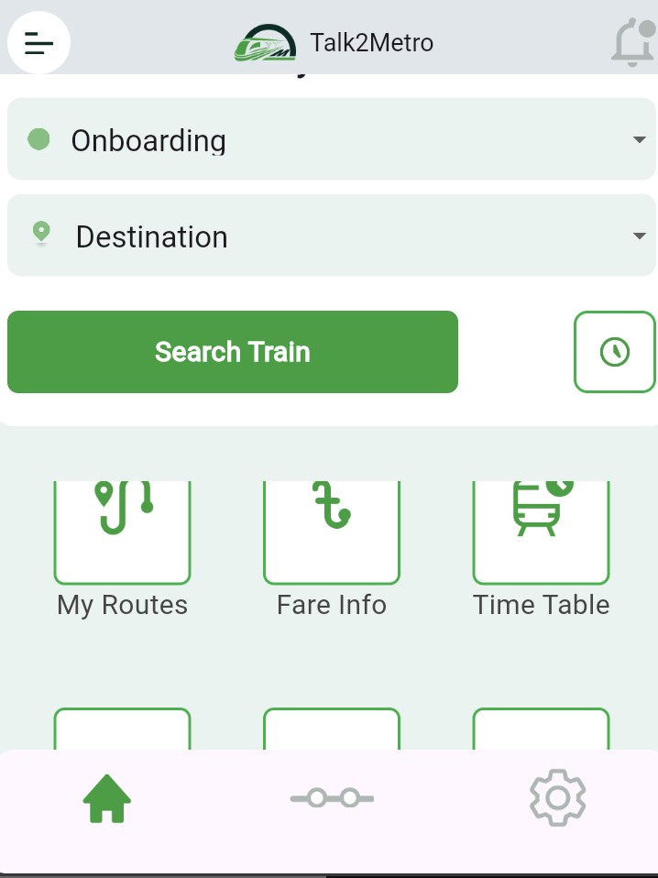
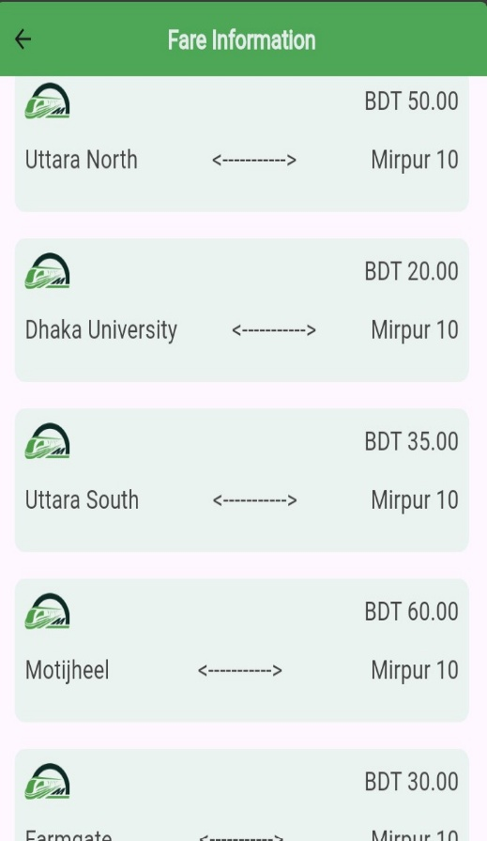
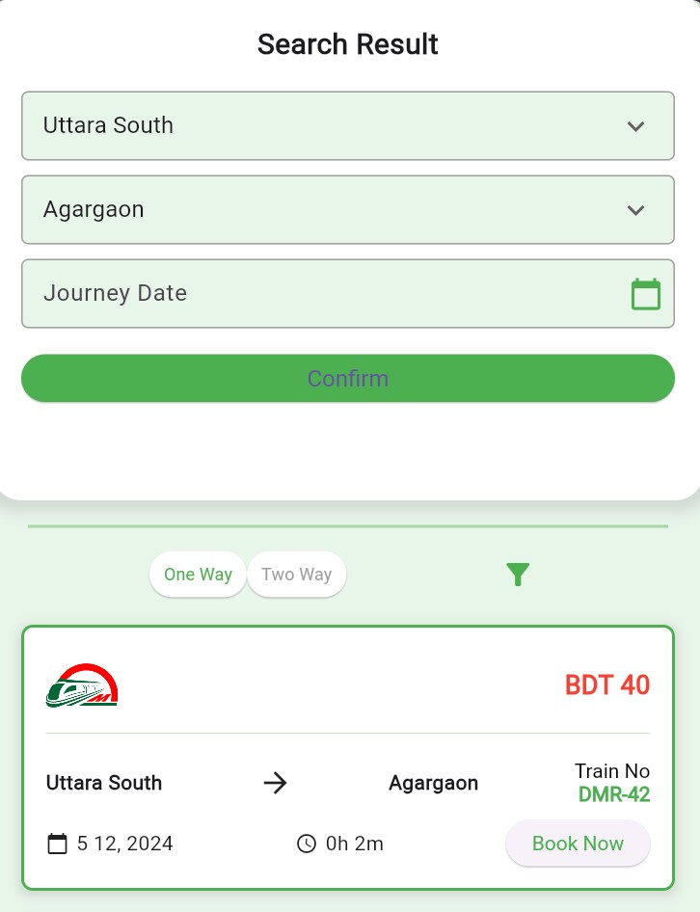
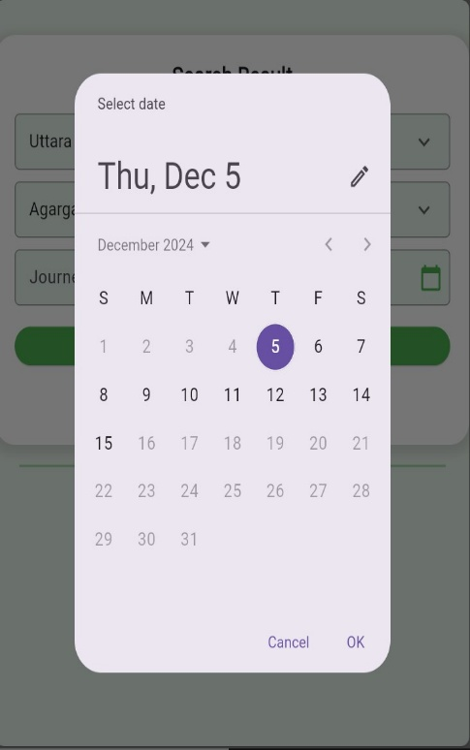
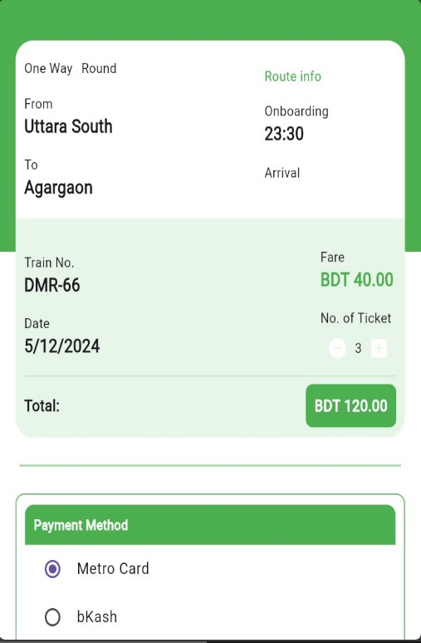
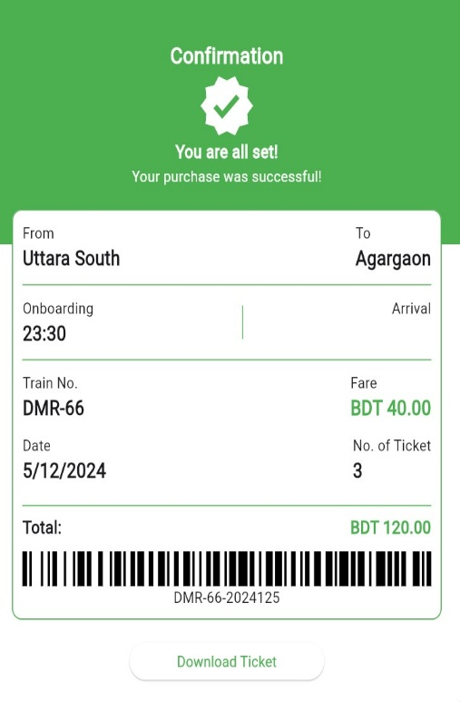

Slide 11
Any
Question
?

Slide 12
THANK YOU

